Slide 1
Global Office 365 Bootcamp – Madrid, Spain
Ruben Ramos Mateo
Arquitecto Soluciones Office 365
Grupo Zertia

Slide 2

Ruben Ramos Mateo
LinkedIn: https://www.linkedin.com/in/rubenramosmateo/
Twitter: https://twitter.com/rubenr79
https://rrcode.wordpress.com

Slide 3
Extendiendo Office 365 con Microsoft Graph API

Slide 4
Introducción a Microsoft Graph API

Slide 5
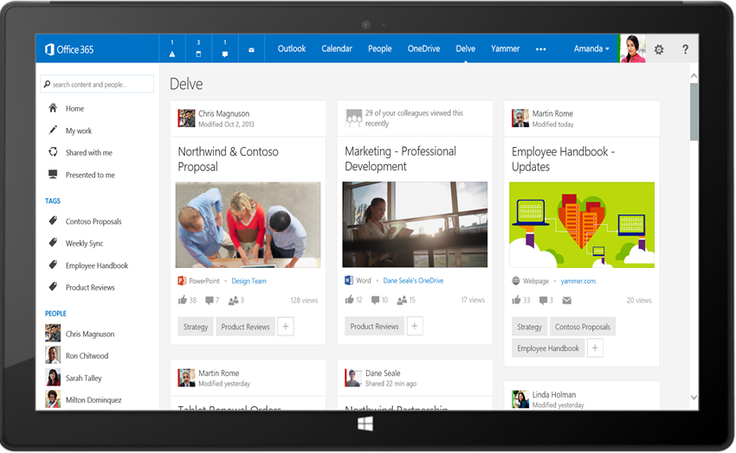
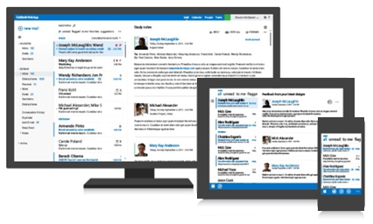




Microsoft Graph API
Your App
https://graph.microsoft.com/
USERS
GROUPS
FILES
MAIL
CALENDAR
TASKS
Insights and relationships from Office Graph

Slide 6
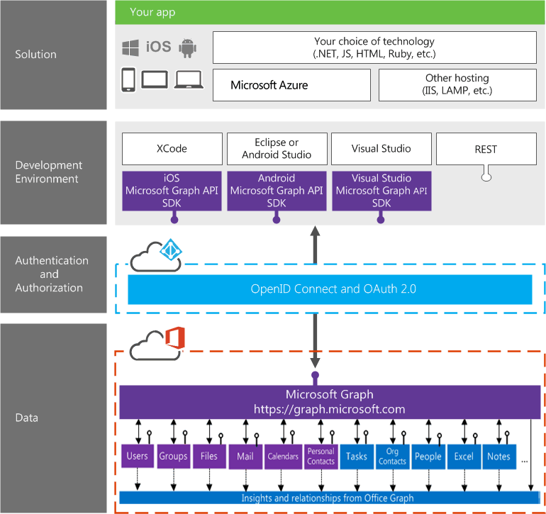
Integración con Office 365

Slide 7
¿Por qué necesitamos Microsoft Graph API?

Slide 8




Data silos in the enterprise
USER
FILES
EMAIL AND CONVERSATIONS
EVENTS
PEOPLE
GROUPS

Slide 9
Varios estilos de API y EndPoints
Azure Active Directory Graph API
https://graph.windows.net/contoso.com/users
https://graph.windows.net/contoso.com/groups
SharePoint User Profile API
https://contoso.sharepoint.com/_api/SP.UserProfiles.PeopleManager/GetMyProperties
Exchange HD Picture API
https://graph.microsoft.com/v1.0/me/photo
Outlook REST API
https://outlook.office.com/api/v2.0/me/Messages
https://outlook.office.com/api/v2.0/me/Events
Office Graph in SharePoint Online
https://contoso.sharepoint.com/_api/search/query?Querytext='*'&Properties='GraphQuery:actor(ME,action\:1020,or(action\:1020\,action\:1003,action\:1001,action\:1024,action\:1005,action\:1037,action\:1039,action\:1036)'&SelectProperties='Docid,Title
OneDrive for Business API
https://contoso-my.sharepoint.com/personal
/jean_contoso_com/_api/v2.0/drive
https://contoso.sharepoint.com/sites
/designCouncil/_api/v2./drive
OneDrive API
https://api.onedrive.com/v1.0/drive
Windows Live Profile API
https://apis.live.net/v5.0/me

Slide 10
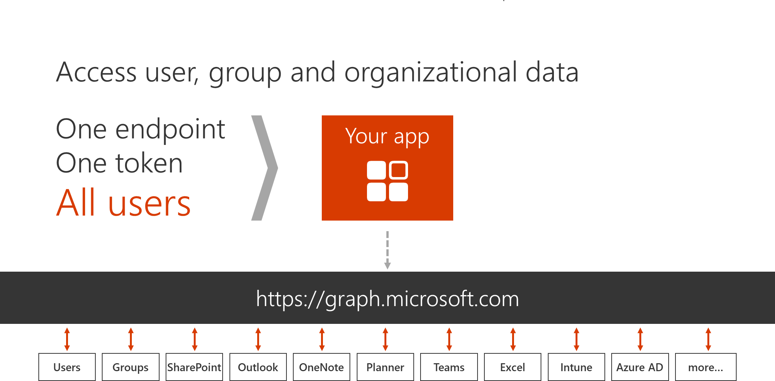
1 App

Slide 11
Breaking silos
USER
FILES
EMAIL AND CONVERSATIONS
EVENTS
PEOPLE
GROUPS

Slide 12
Beneficios de Microsoft Graph API
Enpoint único
Single well-known resource
Solo se necesita un OAuth access token
Navegar por relaciones lógicamente

Slide 13
Calling the API
https://graph.microsoft.com
/{version}
/{resource}
/{id}
/{property}
?{query-parameters}
HTTP verbs dictate the request intent: GET | POST | PATCH | PUT | DELETE
Version: /v1.0 or /beta
Resource: /users, /groups, /sites, /drives, /devices, more…
Member from collection: /users/AAA
Property: /users/AAA/department
Traverse to related resources via navigations: /users/AAA/events
Query parameters: /users/AAA/events?$top=5
Format results: $select | $orderby
Control results: $filter | $expand
Paging: $top | $skip | $skiptoken

Slide 14
API
trendingAround
Shared with me
createdBy
CONVERSATIONS
public
manager
USER
workingWith
directReports
EVENTS
trendingAround
modifiedBy
TASKS
FILES
memberOf
workingWith
TASKS
GROUPS
createdBy
NOTES
NOTES
MESSAGES
FILES

Slide 15
API
trendingAround
Shared with me
createdBy
CONVERSATIONS
public
manager
USER
workingWith
directReports
EVENTS
trendingAround
https://graph.microsoft.com/
modifiedBy
TASKS
FILES
memberOf
workingWith
TASKS
GROUPS
createdBy
NOTES
NOTES
MESSAGES
FILES

Slide 16
Autenticación

Slide 17
Authorization flow
Azure AD Authorization
Endpoint
Azure AD Token
Endpoint
Native Application
Microsoft Graph API
Request authorization code
Sign-in via browser pop-up
Return authorization code
Redeem authorization code and acquire access token for Microsoft Graph
Return tokens
Call Microsoft Graph using the access token
Return Http Response

Slide 18
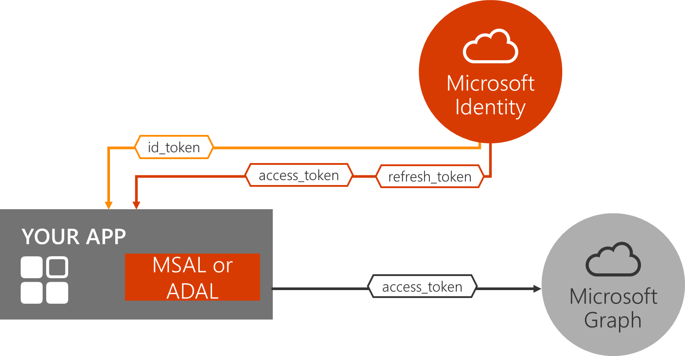
Autenticación

Slide 19
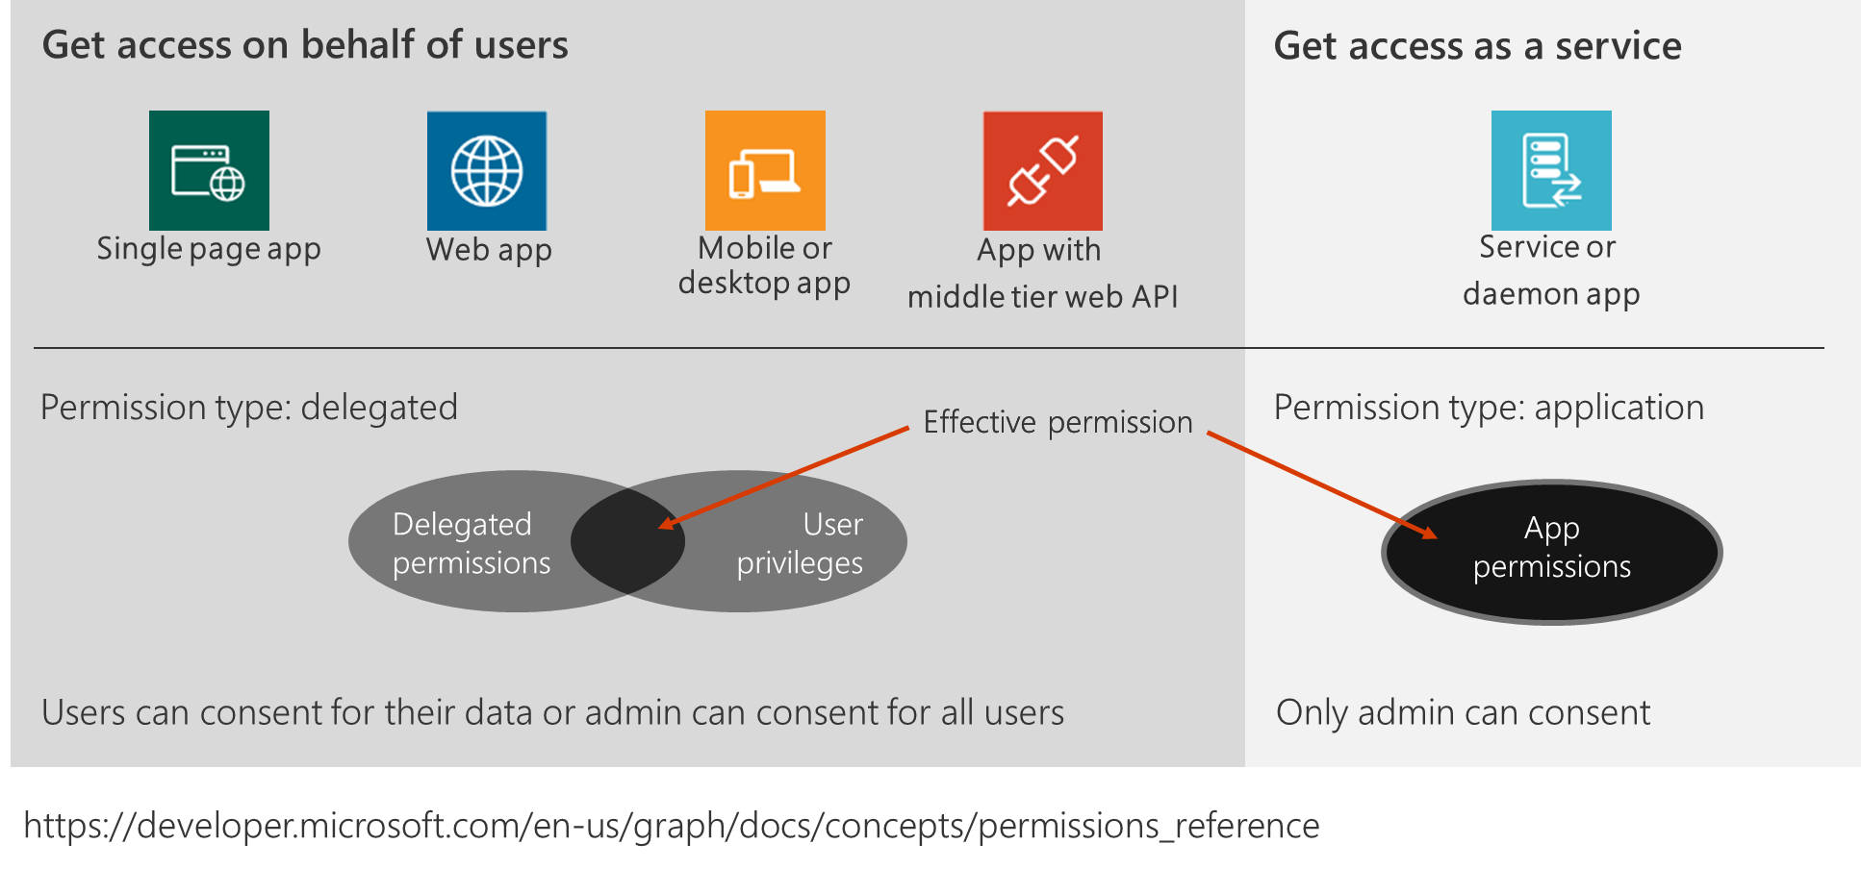
Permisos

Slide 20
Libraries: http://github.com/AzureAD
Client: Active Directory Authentication Library (ADAL)
.Net, Windows Store, Windows Phone
JavaScript
iOS
Android
Xamarin
Cordova
Node.js
Java
Server
.Net: ASP.Net OWIN middleware for OpenID Connect and OAuth 2.0
Node.js
More to come

Slide 21
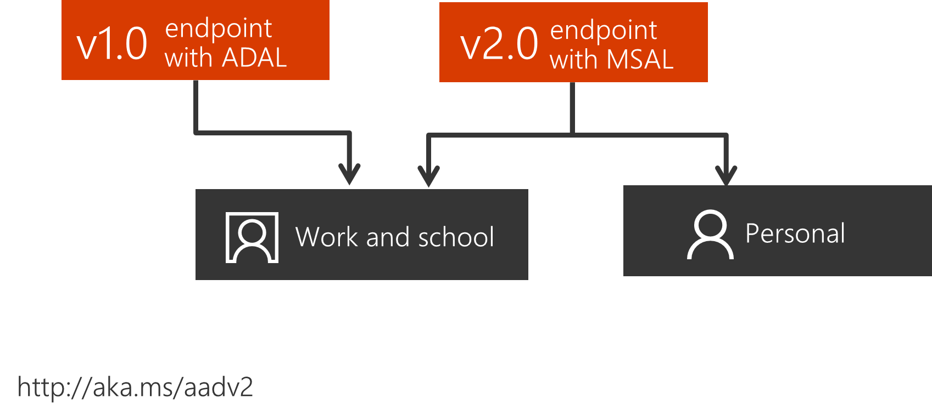
ADAL vs MSAL

Slide 22
REST API vs SDK
User me = await graphClient.Me.Request().Select("mail,userPrincipalName").GetAsync();
return me.Mail ?? me.UserPrincipalName;
using (var client = new HttpClient())
{
using (var request = new HttpRequestMessage(HttpMethod.Get, endpoint + queryParameter))
{
request.Headers.Accept.Add(new MediaTypeWithQualityHeaderValue("application/json"));
request.Headers.Authorization = new AuthenticationHeaderValue("Bearer", accessToken);
using (HttpResponseMessage response = await client.SendAsync(request))
{
if (response.StatusCode == HttpStatusCode.OK)
{
var json = JObject.Parse(await response.Content.ReadAsStringAsync());
me.Address = !string.IsNullOrEmpty(json.GetValue("mail").ToString()) ? json.GetValue("mail").ToString() : json.GetValue("userPrincipalName").ToString();
}
return me.Address?.Trim();
}
}
}

Slide 23
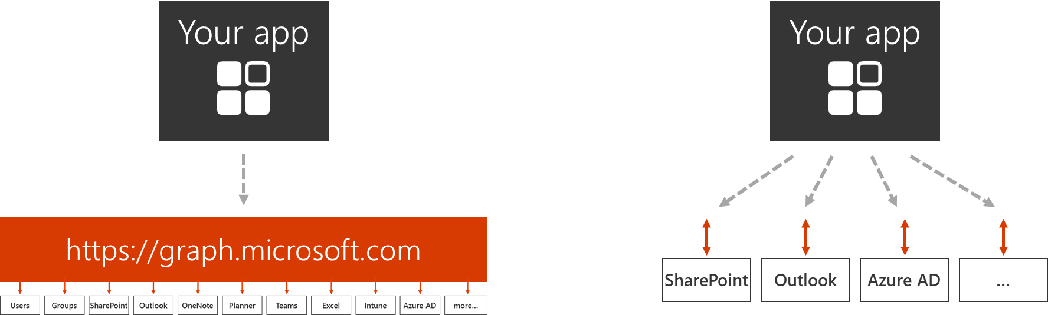
Service API vs Microsoft Graph API

Slide 24
A currar!!

Slide 25

Enjoy the Bootcamp
https://github.com/rubenr79/Global-Office-365-Developer-Bootcamp-2017

Slide 26

Call to action
(Recommendation to Bootcamp organizers and speakers: This slide can be used at the end of the Bootcamp to have attendees to fill online feedback form and recommendation for their ongoing learning and app development on Office 365 platform. Please keep the first three bullet points, you can update the last bullet point to be the user group or community that you are leading that you’d like attendees to join and learn more. Please keep the first feedback bullet point at the top and feel free to re-arrange the rest of bullet point orders. Thanks.
Share your feedback on Bootcamp at https://aka.ms/o365devbootcampfeedback
Join Office 365 developer program https://dev.office.com/devprogram to leverage all resources for Office 365 development learning
Build applications on Office 365 platform
Attend MVP led local community events to continue learning on Office 365 development

